Slide 1
User Interface Automated Testing
Obviously not from a Web Designer
Notes:
Introduce yourself. These people don’t know you. Give your qualifications.

Slide 2
Testing a Web Application
Three basic levels of automated testing for a web application
Unit Testing
Functional Testing
End-to-End Testing
Unit Tests are primarily for design
Functional Tests encompass many different types of testing
Service-Based Tests
Database Tests
User Interface Tests
End-To-End Tests are very valuable but expensive and brittle
Notes:
Talk about each type of Tests and their benefits and drawbacks

Slide 3
What Are UI Automated Tests?
User Interface Automated Tests:
Are developed from the user’s perspective
Should specifically test the User Interface functionality only
Do not typically follow the AAA (Arrange Act Assert) pattern
Have a need to separate test failures from system failures
Rely on tools to automate the browser (i.e. Selenium)
Notes:
Why is this so powerful? Is this like Automated UAT? Is Selenium the only tool available?

Slide 4
What is the Value?
Nothing else better tests the User Interface without manual intervention
Saves your QA’s time by automating monotonous steps
Can be run every deployment (or on some schedule)
The User Interface is the primary way you interact with your users
Can replace most UAT (User Acceptance Testing) regressions
Notes:
The potential benefit for your business is huge but building takes time. Talk about getting the business on board.

Slide 5
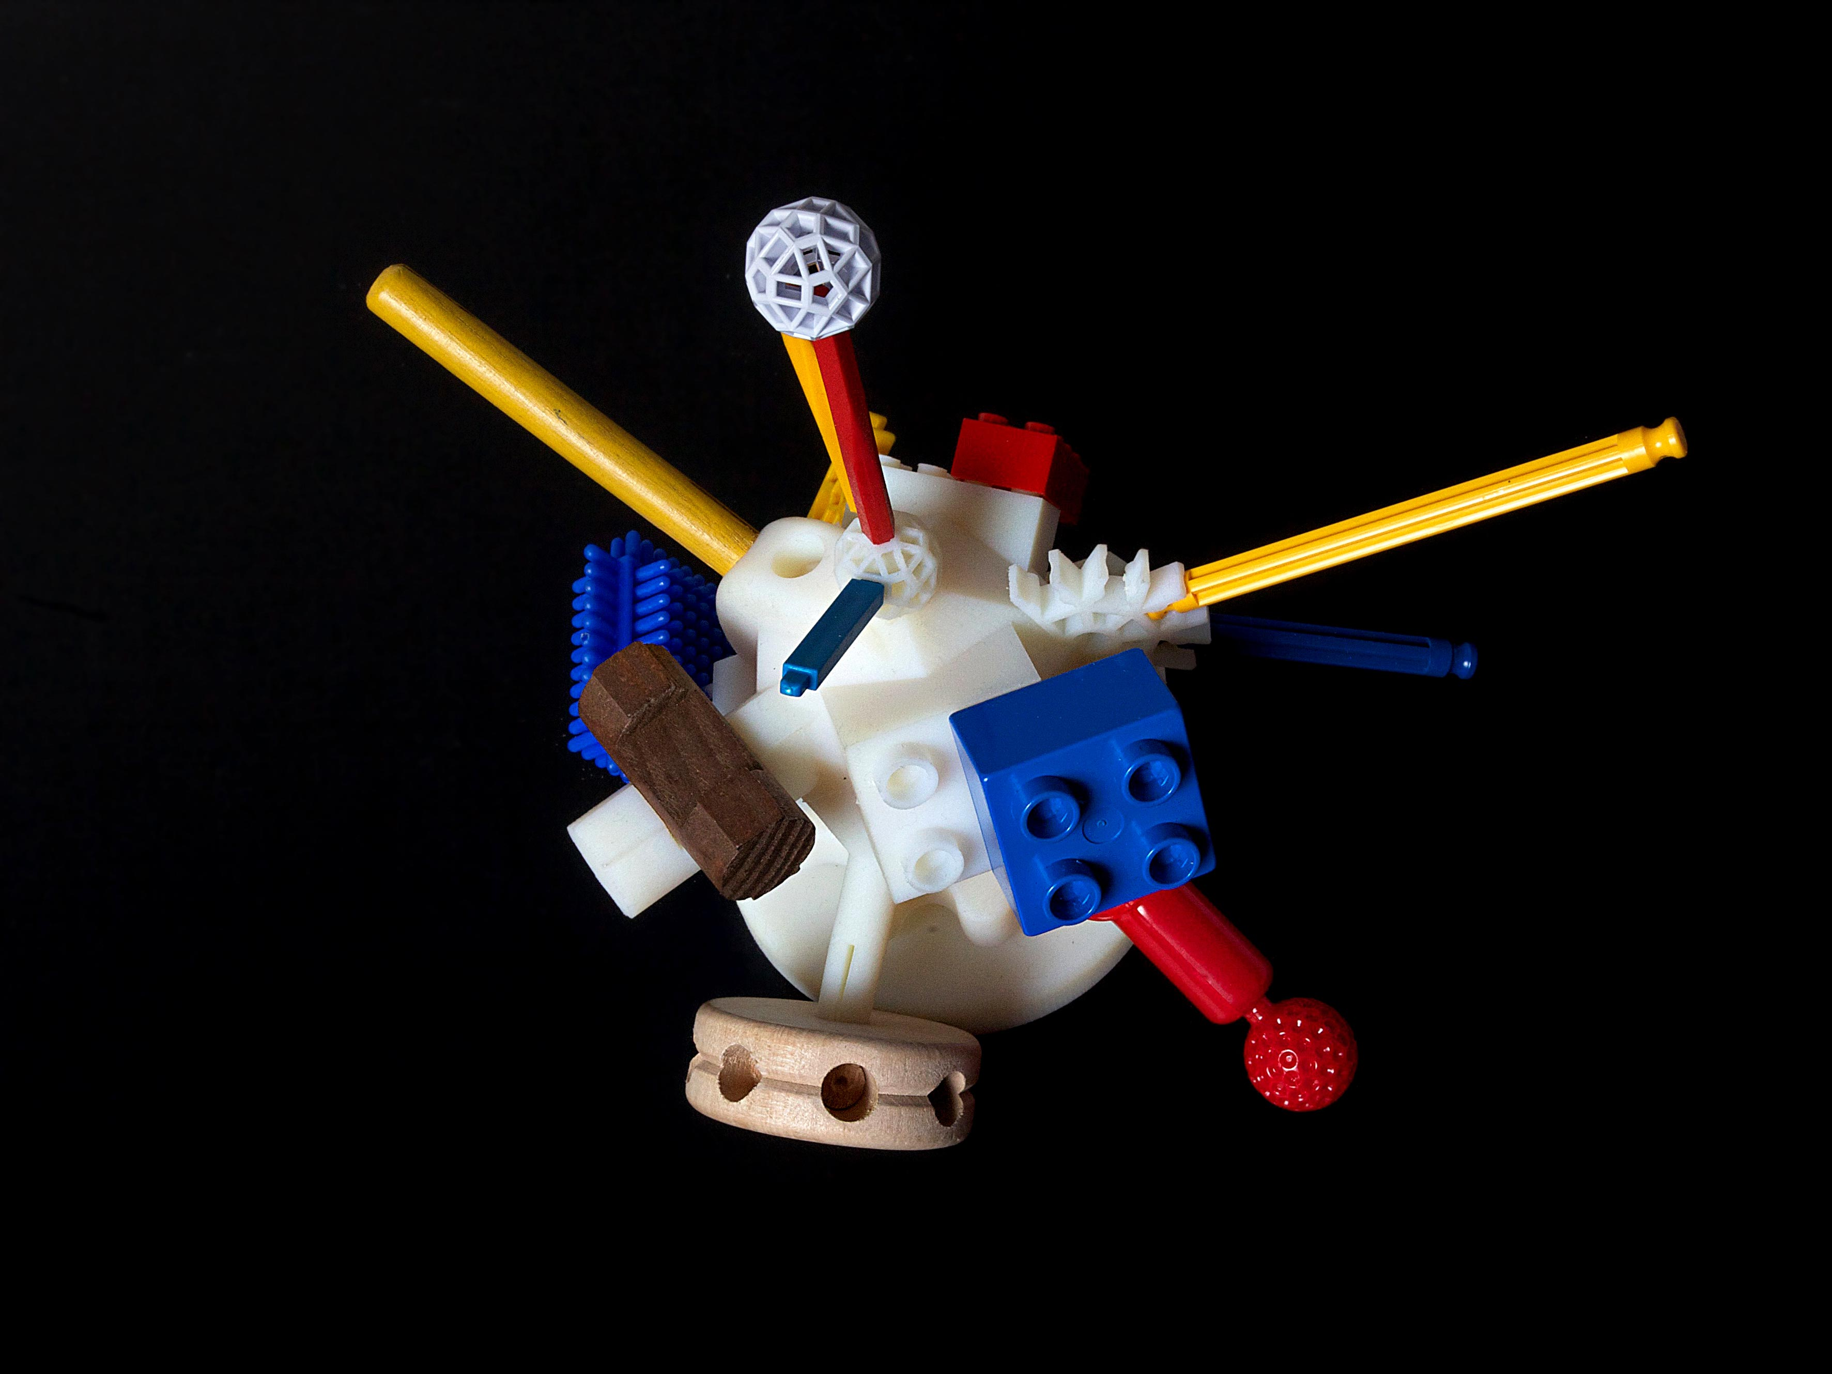

A Note About Tools
What I think I’m building
What I’m actually building
Notes:
Anecdotes about people building something either too convoluted or not useful

Slide 6
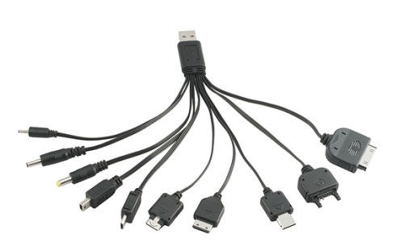
What I Should be Building
Notes:
Talk at length about the importance of abstracting away tools (esp. 3rd party tools)

Slide 7
Creating an Automation Framework: Demo Time!
Decide on the tools you want to incorporate
Choose a single, simple test
Build only the foundation you need to complete that test
Use the Page Pattern
Once that test is complete, build out gradually using more complex tests
Notes:
Talk about building this framework and how it came together

Slide 8
Best Practices
Don’t tie yourself to a tool
Build for readability, scalability, and efficiency (in that order)
Get QAs involved from the beginning (for functional tests as well)
Abstract away as many implementation details as possible
Don’t be vague when you can be clear
Notes:
Talk at length about each of these

Slide 9
For further information
GitHub
@jperktweets
Selenium
Getting Up to BAT
Notes:
Let people know where each of these links go

Slide 10
Questions?

